Slide 1
Ophthalmic Anesthesia 2025/26
Leulayehu Akalu
Ass Prof

Slide 2
Objectives
Provide safe anesthesia for emergency and elective ophthalmic procedures .

Slide 3
Introduction
Ophthalmic surgery is one of the most common procedures that require anesthesia.
Anesthesia Options in ophthalmology include local anesthetic options such as topical, sub-Tenon's, peri bulbar and retro bulbar techniques as well as general anesthesia.

Slide 4
Indications of regional techniques
Regional anesthesia is indicated in that subset of ophthalmologic surgeries in which general anesthesia is not needed, and particularly for those surgeries requiring patient cooperation. The subset of surgeries appropriate for regional ocular anesthetic includes nearly all intraocular surgeries, including for example cataract removal, corneal transplantation, glaucoma surgeries, vitreoretinal surgeries, scleral buckling, strabismus repair, and Enoculations .

Slide 5
Patient preparation before regional anesthesia
Education
Patient education about what to expect prior to surgery is important to reduce anxiety and increase compliance.
Preoperative assessment
Specifically ask about bleeding disorders, and anti-coagulant or anti-platelet drugs. Note that patients receiving anti-coagulants may continue medications as long as levels are within therapeutic ranges, whereas there is no current recommendation for patients on anti-platelet agents. An axial length measurement of the eye may be useful if considering a retrobulbar block, for the increased risk of globe or optic nerve damage in long eyes.

Slide 6
Axial length
The axial length of the eye is the measure from front to back – measured from the front surface of the cornea (the clear window over the coloured iris of the eye) right through to the back curve of the eye underlying the retina (the light sensitive layer at the back of the eye).. The mean adult values for axial length are 22-25 mm and mean refractive power -25.0 -+1.0 D. The mean depth of the anterior chamber in an adult emmetropic eye is 3-4 mm. a person with perfect vision, also known as '20/20 sight
Axial length measured by Myopia Expert 700 optical biometer
Accumulating evidence from human studies point out that both heredity and the environment contribute to the refractive power of the eye
Axial Length, Anterior Chamber Depth-A Study in Different Age Groups and Refractive Errors (Study )

Slide 7
Key concepts in ophthalmology
Any factor that normally increases intraocular pressure will tend to decrease intraocular volume by causing drainage of aqueous or extrusion of vitreous through the wound. The latter is a serious complication that can permanently worsen vision.
Succinylcholine increases intraocular pressure by 5–10 mm Hg for 5–10 min after administration, principally through prolonged contracture of the extra ocular muscles.

Slide 8
Key concept
Traction on extra ocular muscles or pressure on the eyeball can elicit a wide variety of cardiac dysrhythmias ranging from bradycardia and ventricular ectopic to sinus arrest or ventricular fibrillation.
Complications involving the intraocular expansion of gas bubbles can be avoided by discontinuing nitrous oxide at least 15 min prior to the injection of air or sulfur hexafluoride.

Slide 9
Key concept
Topically applied drugs are absorbed at a rate intermediate between absorption following intravenous and subcutaneous injection.

Slide 10
Echothiophate is an irreversible cholinesterase inhibitor used in the treatment of glaucoma. Topical application leads to systemic absorption and a reduction in plasma cholinesterase activity. Because succinylcholine and mivacurium are metabolized by this enzyme, echothiophate will prolong their duration of action

Slide 11
Key concept
The key to inducing anesthesia in a patient with an open eye injury is controlling intraocular pressure with a smooth induction. Specifically, coughing during intubation must be avoided by achieving a deep level of anesthesia and profound paralysis.
The post retrobulbar apnea syndrome is probably due to injection of local anesthetic into the optic nerve sheath, with spread into the cerebrospinal fluid.

Slide 12
Monitored anesthesia care
Regardless of the technique employed for intravenous sedation, ventilation and oxygenation must be carefully monitored, and equipment to provide positive-pressure ventilation must be immediately available

Slide 13
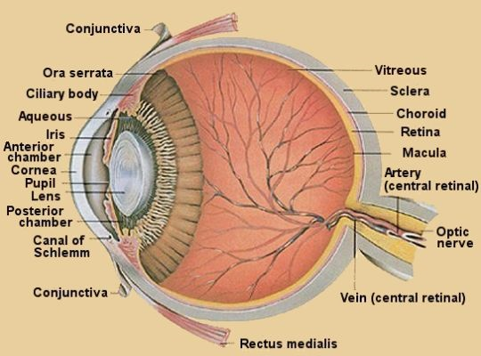
Anesthesia for ophthalmic surgery

Slide 14

Anesthesia for Ophthalmic surgery

Slide 15
Requirements for ophthalmic surgery
Safety
Akinesia
Profound analgesia
Avoidance and obtundation of occulo cardiac reflex
Proper control of intraocular pressure
Awareness of drug interaction
Smooth emergence with no vomiting or coughing

Slide 16
Requirements for intraocular procedures
Meticulous control of I.O.P
Profound akinesia

Slide 17
Requirements for extrocular procedures
Avoidance or obtundation of occulocardiac reflex
MHT
Smooth emergence with no coughing or vomiting

Slide 18
General evaluation
Pre-operative
Perioperative decisions regarding comorbid conditions and chronic medications

Slide 19
Anesthesia Considerations
Most ophthalmic surgeries can be performed using monitored anesthesia care (MAC), along with topical or regional anesthesia techniques or General anesthesia depending on the type of the procedure

Slide 20
Evaluate Communication and Collaboration
When anesthesia is planned, it is important that the patient be able to lie comfortably still during the procedure and communicate effectively .

Slide 21
History
a .Myocardial infarction within the last month
b. Recent percutaneous coronary intervention (within 14
days without stents or within 30 days with stents)
c. New onset of clinically significant arrhythmias

Slide 22
d. Decompensated heart failure
e. Presence of a serious pulmonary condition (e.g., upper
respiratory tract infection, pneumonia, and pulmonary
embolism) or worsening of a serious chronic condition
(e.g. COPD)

Slide 23
f. New onset of neurological condition (e.g., stroke,
transient ischemic attack, and mental status changes)
g. Malignant hypertension with recent organ damage
(e.g., encephalopathy, myocardial ischemia, and acute
kidney injury)

Slide 24
h. Recent episode of diabetic ketoacidosis or hyperglycemic hyperosmolar non-ketotic coma.

Slide 25
Physical Examination
A standard physical examination, including the airway, is
performed to identify any abnormalities that may interfere
with the patient’s surgery.

Slide 26
Pre-Operative Tests
Pre-operative tests, including a hematology, biochemistry panel, and clotting times, should be carefully chosen based on the patient’s medical history, existing health conditions determined through physical examination, and the nature of the planned surgical procedure.

Slide 27
Ophthalmic Considerations
Anticoagulant and Antiplatelet Therapies In patients at high risk for coagulation and embolic complications due to cardiac or vascular pathology, therapeutic doses of aspirin and warfarin are frequently continued throughout the pre-operative period. because there is a real risk of recurrent cardiac ischemia or stent thrombosis.

Slide 28
Axial Length of the Eye
The distance from the cornea to the retina, known as the axial length of the eye, is typically measured using ultrasound before cataract surgery.
Increased risk of needle injury during retrobulbar block in patients with axial length >25 mm.In such patients, peribulbar (extraconal) or sub-Tenon’s block, topical anesthesia, or general anesthesia are preferred over retrobulbar block.

Slide 29
Position
To avoid back and neck discomfort, position the patient’s head at the upper end of the operating table.
To minimize unintended movement, provide adequate support for the patient’s head using a comfortable headrest.
Collaborative effort between the anesthetist and the patient is mandatory during positioning .

Slide 30
Intra ocular pressure
IOP refers to the pressure exerted by the contents of the
eye on the surrounding structures.
Elevated pressure
can lead to a reduction in blood flow to critical ocular
structures, including the retina, choroid, and optic nerve.

Slide 31
Typically, normal IOP is in the range of 10-15 mmHg or 16±5 mmHg, with fluctuations of 2–3 mmHg observed throughout the day.
Values greater than 24 mm Hg are considered pathologic.
Any disturbance in the outflow of aqueous humor can
lead to a sudden increase in IOP

Slide 32
Blood supply to the eye
The arterial input to the eye is provided by several branches from the ophthalmic artery, which is derived from the internal carotid artery

Slide 33
As one of the most metabolically active organs in the body,
the retina depends on the retinal and choroidal circulation
for its nutrition. Interestingly, the retinal circulation is an
end-arterial system and is influenced by metabolic activity
but does not receive autonomic innervation

Slide 34
The choroidal circulation supplies a substantial 85% of the
retina, providing vital nutrients to the retinal pigment and
photoreceptors. The intricate interplay between IOP and
mean arterial pressure is pivotal in governing the regulation of both choroidal and retinal circulation.

Slide 35
Innervation of the eye
Occulo motor nerve
Trochealer nerve
Abducens nerve
Trigeminal nerve
Zygomatic branch of facial nerve

Slide 36
III /IV /VI Nerves
They enter the orbit through superior orbital fissure
III&VI-enter extra ocular muscle cone
IV –to superior oblique muscle &remains out side the muscle cone

Slide 37
Sensory innervation
Trigeminal nerve
First division-ophthalmic
Second division-maxillary
Third divison-mandibular

Slide 38
Eye muscles
Extrinisic
They attach to the outside of the eye ball and to the bone of the orbit
Intrinsic
they are smooth and involuntary
Iris and ciliary muscle
iris-regulate the size of the pupil
Ciliary muscle –control shape of the lenses

Slide 39
Formation of retinal images
Different processes to focus light rays to form clear image
Refraction of light rays
Bending of or deflection of light rays when passing obliquely from one transparent media into an other or different optical density If more convex surface → more refractive power

Slide 40
Convergence of the eyes
The movement of two eye balls in ward so that their visual axis come together or converge at the object viewed.
Nearonal mechanism for convergence cause as simultaneous signal to strength the lense of the eye.

Slide 41
Constriction of the pupil
Prevents divergent rays from object entering the eye through the periphery of cornea and lenses.
Constriction of the pupil by contraction of the circular fibers of the iris to Control the pupillary diameter

Slide 42
Parasympathetic stimulation - Excites pupillary sphincter muscle there by decreasing pupillary aperture which is called moisis
Stimulation of the SNS excites the radial fibers of the iris and causes pupillary dilation which is called mydriasis

Slide 43
Neuronal pathway for pupilary reaction
- Light impulse on retina
↓
- Resulting impulse pass through optic nerve
↓
- To optical tracts
↓

Slide 44
- To pre tectal nuclei
↓
- To Edinger west phal nucleus
↓
- Finally back through PNS
↓
- To constrict the sphincter of Iris (Darkness )

Slide 45
Accommodation Mechanism
Results from contraction or relaxation of the ciliary muscle
Contraction - causes in creased strength of the lense system
Relaxation - causes decreased strength
Accommodation → results by negative feed back mechanism that automatically adjust the focal power of the lense for the highest degree of visual acuity.

Slide 46
When eyes suddenly change the distance of the fixation point the lense always change its strength in the proper direction to achieve a new state of focus (no mistake by the lense)
Degree of accommodation of lense oscillates all the time up to two times per second.

Slide 47
Stimulation of the retina
Both rods and cones contain photopignent (light sensitive compounds)
The photo pigment in rods is - Rhodesian (highly light sensitive even in deem light causing its break down (produce vision in deem light)
Conduction to visual area

Slide 48
The photo pigment cones contains three types. Erythrolable, colorable &
cyanable (primary colors which reflect light rays).
The fovea centralis - contains greatest concentration of cones. (the point of clearest vision in good light).while Rodes deem light

Slide 49
Conduction to Visual Area
Fibers that conduct impulse from rods and cones reach visual cortex in the occipital
lobes via visual pathways .
From two retinas to → the visual cortex.
After nerve impulse leave retina → they pass back ward through optic nerves

Slide 50
Optic chaism → all the fibers from the nasal halves of the retinas cross to the opposite side where they join the fibers from opposite temporal retinas to form the optic tracts

Slide 51
Optical tracts synapse in the dorsal lateral geniculate nucleus and
from here the geniculo calcarine fibers and pass by way of the optical radiations or geniculocal carine tract to the primary visual courtex in the calcarine area of the occipital lobe

Slide 52
Visual Fibers also pass to the older precortical areas of the brain
a. From optic tracts to the suprachaismatic nucleus of the hypothalamus. Presumably for controlling circadian rhythms
b. In to the pertectal nuclei for eliciting some reflex movements of the eyes focused on objects of importance and also for activating the pupillary light reflex

Slide 53
c. Into superior colliculus for control of rapid directional movements of the two eyes
d. Into the ventral lateral geniculate nucleus of the thalamus and hence into the surrounding basal regions of the brain. Presumably to help control some of the body's behavioral functions.

Slide 54
Summary of visual pathways
Retina
optical nerve
optic chaism
optical tracts
optical radiation
then reach to primary visual area in the calcarine area of the occipital lobe

Slide 55
Fluid system of the eye
Eye ball is not a solid sphere contains fluid called aqueous and vitreous humor
Aqueous humor- lies in front and to the sides of the lenses (freely flowing fluid)
Vitreous humor –lies between the lenses and retina

Slide 56
Eye filled with intraocular fluid and maintain sufficient pressure in the eye ball to keep it distended

Slide 57
Chambers
Anterior chamber-anterior to iris posterior to cornea
Posterior chamber –small space posterior to iris and anterior to lenses

Slide 58
Posterior cavity
Larger space posterior to lenses/suspensory ligament and ciliary body

Slide 59
Types of fluids
Aqueous humor- lies in front and to the sides of the lenses (freely flowing fluid)
Vitreous humor –lies between the lenses and retina

Slide 60
Viterious
Gelatinous mass held together by a fine fibrilar
Network composed mainly of large proteoglycan molecules

Slide 61
Formation and drainage
2/3 formed in the anterior cavity by ciliary body
Active secretary process by carbonic anhydrase and cytocrome oxidase system

Slide 62
1/3 by passive filtration from the vessels on the anterior surface of the of the iris

Slide 63
Na+---actively transported to –AH at posterior chamber -----Hco3 Cl passively follow Na+ --H2o follows them ---it is this disparity of the pressure that helps to form 2-3uml /minute of AH

Slide 64
Out flow
AH ---originates as plasma filtrate from capillaries of ciliary body
Secreted across ciliary epithelium in to posterior chamber
From posterior chamber through pupillary aperture into anterior chamber (here mixed with AH formed by the iris)
During its travel AH bathes the a vascular lenses provides nutrient materials and remove wastes

Slide 65
When AH reaches to anterior chamber it baths the corneal endothelium and maintain healthy corneal metabolism and flow to the peripheral segment of anterior chamber
Exit the eye via trabecular mesh work /canal of shlemm/episcleral venous system
Finally it enters to superior venacava and to the right side of the heart (any obstruction between this net work will increase the intra ocular pressure.

Slide 66
Aqueous humor is produced by the ciliary epithelium (2–3 μl/minute) into the posterior chamber of the ocular anterior segment. The fluid then circulates around the lens and through the pupil to the anterior chamber

Slide 67
Volume of the aqueous is about 0.31 ml (0.25ml in anterior chamber and about 0.06 ml in the posterior chamber). ✓ Refractive index of the aqueous is 1.336 ✓ Osmotic pressure: Aqueous is slightly hyper osmotic to plasma by 3 to 5 mOsm/l. ✓ pH of the aqueous is acidic with a pH in the anterior chamber of 7.2.

Slide 68
Conclusion
The aqueous humor occupies the anterior and posterior chambers of the eye and is responsible for providing nutrients to the avascular lens and the endothelial aspect of the cornea The volume of aqueous humor (0.3 mL in the adult) is primarily responsible for intraocular pressure (IOP) regulation..

Slide 69
The vitreous humor, created embryologically between 1 and 4 months’ gestation, is a hydrophilic gel that accounts for 80% of the volume of the globe. The vitrous humor is 99% water, although in the presence of hyaluronic acid (a mucopolysaccharide), its viscosity is twice that of water. The volume of the vitreous humor is more constant than that of the aqueous humor, although it may be slightly influenced by hydration status and osmotically active medications

Slide 70
Factors influencing IOP
1-external pressure on the globe
2-scleral rigidity
3-changes in the intra ocular contents that are semisolid
4- diameter of Fontana's space
5-Laryngoscopy and ETT
6-diurinal variations

Slide 71
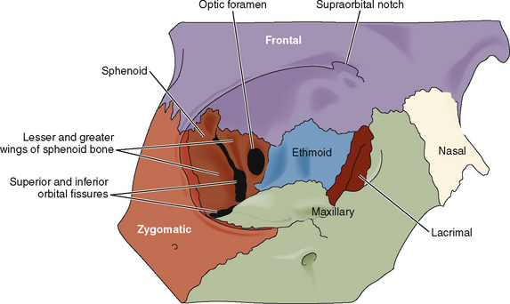
Orbit

Slide 72
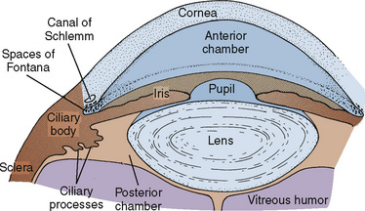
Fontana's space

Slide 73
space of Fontana
"space of Fontana" is the spaces between the trabeculae of the eye's Descemet's membrane, through which the anterior chamber communicates with the canal of Schlemm. interconnected spaces located within the eye's angle of drainage.
It acts as a pathway for the fluid (aqueous humor) from the anterior chamber to flow through to the canal of Schlemm, an important factor in glaucoma treatment.

Slide 74
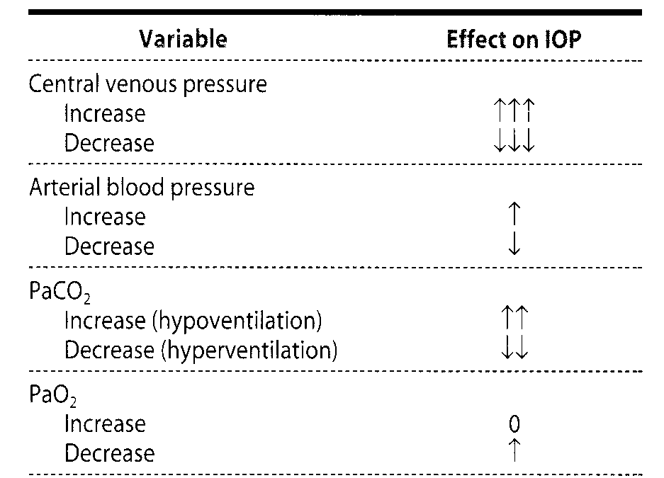
Events that alter intraocular pressure

Slide 75
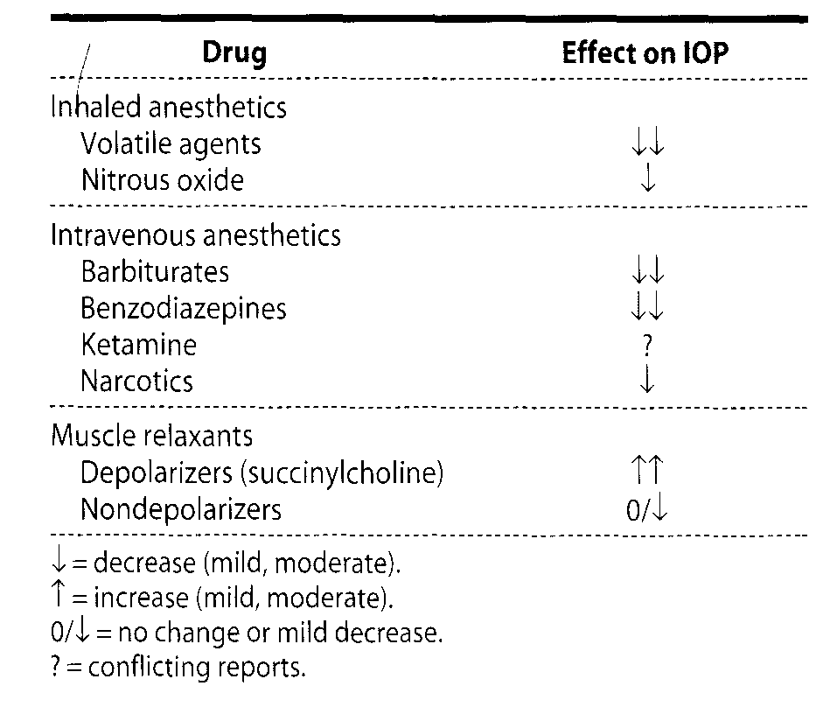
The Effect of Drugs and Agents on Ophthalmic Anesthesia

Slide 76
Influencing factors cont”d
Endotracheal intubation –appears to increase IOP(topical anesthesia)
Hyper ventilation-decreases IOP
Hypoventilation-increases IOP
Hypothermia-decreases IOP by causing vasoconstriction and deceasing AH production

Slide 77
Terminology to be familiar in ophthalmology
Blepharospasm: Tonic spasm of the orbicularis oculi muscle, producing more or less complete closure of the eyelids
Buphthalmos: Enlargement and distention of the fibrous coats of the eye
Cyclocryotherapy: Freezing of the ciliary body, performed for the treatment of glaucoma

Slide 78
Epiphora: Abnormal overflow of tears, also known as illacrimation
Episcleritis: Inflammation of tissues overlying the sclera, also inflammation of the outermost layers of the sclera
Gonioscopy: Examination of the angle of the anterior chamber of the eye

Slide 79
Goniotomy: Operation for glaucoma characterized by an open angle and normal depth of the anterior chamber; consists of the opening of Schlemm’s canal under direct vision secured by a contact glass
Tonometry: Measurement of tension or pressure commonly assessed by the applanation

Slide 80
Tonometer: Instrument that measures intraocular pressure by determination of the force necessary to flatten a corneal surface of constant size
Trabeculectomy: Creation of a fistula between the anterior chamber of the eye and the subconjunctival space by surgical removal of a portion of the trabecular meshwork

Slide 81
Strabismus surgery concerns
Forced duct ion test –to know site of mechanical restriction20 minutes before FDT don't use SCCH
Occulo cardiac reflex—major cause is traction on the medial rectus muscle
Occulogastric reflex
Malignant hyperthermia
Post operative pain

Slide 82
OculO cardiac reflex
Afferent limb is trigeminal
Efferent limb is vagal
Exaggerated during hypoxia /hypercarbia
If no prophylaxis of atropine is given

Slide 83
The Oculocardiac Reflex (OCR) is manifested by
Braycardia
Bigeminy
Ectopic
Nodal rhthms
Atroventricular block
Cardiac arrest

Slide 84
Manifestations
Traction on the extraocular muscles (medial rectus)
Ocular manipulation
Manual pressure on the globe

Slide 85
Manifested during
Eye muscle surgery
Detached retina repair
Enucleation

Slide 86
Preoperative anxiety
light general anesthesia
Hypoxia
Hypercarbia
Increased vagal tone owing to age

Slide 87
Management
Give atropine for all children before surgery IV during the time of induction
D/C manipulation
Asses ventilatory status
Avoid hypoxia and hypercarbia
No atropine during active phase
Monitoring (ECG)
N.B during strabismus surgery give anti emetics

Slide 88
Anesthesia for different ophthalmic procedures unique concerns and basic requirements
Factors influencing choice of anesthesia
Nature and duration of surgery
Coagulation status
Patients ability to communicate and cooperate
Personal preference of the anesthetist.

Slide 89
Anesthesia for intraocular procedures
Proper control of IOP
Drug interactions
Akinesia
Associated systemic diseases

Slide 90
Events that alter IOP
Decrease IOP
Volatile agents
Hyper ventilation
All IV agents except ketamine
Hypothermia
Mannitol &glycerine
NDMR

Slide 91
Increase
Venous congestion (coughing straining vomiting )
Direct laryngoscopy
SCCH
Arterial hypoxemia
hypoventilation

Slide 92
Anesthetic events that alter IOP
laryngoscopy
Intubation
airway obstruction
Coughing
Trendelenburg position

Slide 93
Inhalation agents
Inhalational anaesthetics decrease intraocular pressure in proportion to the depth of anesthesia.
The decrease has multiple causes: mechanisims
A drop in blood pressure reduces choroidal volume
relaxation of the extra ocular muscles lowers wall tension
pupillary constriction facilitates aqueous outflow

Slide 94
Intravenous aesthetics drugs decrease intraocular pressure Exception is ketamine, which usually raises arterial blood pressure and does not relax extra ocular muscles.

Slide 95
Succinylcholine increases intraocular pressure for 5—10 minutes
principally through prolonged contracture of the extra ocular muscles.
Non depolarizing muscle relaxants do not increase intraocular pressure.

Slide 96
Formation of glaucoma
Anterior chamber displacement of lenses and iris ----shallowness of anterior chamber angle ---reducing of access of AH to trabecular mesh work –forms Glaucoma .

Slide 97
Anesthesia for Glaucoma patients
Types of surgeries
Laser Argon laser trabecoloplasty to treat open angle glaucoma )
Incisional Trabeculectomy removing part of the eye drainage tubes to allow fluid to drain more easily )
Cyclophotocoagulation ;To reduce both pressure and fluid production by laser
Laser Iridotomy to make tiny hole near the iris (different than cutting off the piece of iris )
Glacoma implant surgery

Slide 98
Types of glaucoma
Open angle –This is the most common type developing slowly here the pressure small and the cause is impended exit of AH through the trabecular mesh work
Close angle Glaucoma the increase in pressure high and sudden here the iris blocks
Congenital Glaucoma at neonatal age birth defect
Secondary Glaucoma is caused by underlying medical causes or trauma (There is a cause Optic nerve damage or vision loss )

Slide 99
Anesthetic management for glaucoma
Be aware of the effect of anesthesthetic drugs on IOP(Proper selection of drugs is mandatory )
Consider the use of moitics drugs and its implication with your anesthetic agents
Avoid venous congestion

Slide 100
Avoid over hydration
Cyclocryotherapy( Aprocedure that uses a cryo-probe to freeze and destroy part of the ciliary body in the eye to reduce IOP)
Proper control of IOP
Obtund laryngeal reflexes during laryngoscopy
Increase ventilation

Slide 101
Extubation of glaucoma patients
Extubate when deep in lateral position
IV lidocaine 1-2mg to prevent coughing
Anti emetics
Use reversal agents with minimal effect on pupilary size and IOP

Slide 102
Interaction of Topical ophthalmic drugs
Topical ophthalmic drugs can be absorbed through the conjunctiva, or they drain through the nasolacrimal duct and be absorbed through the nasal mucosa.
Usage of topical medications can have implications for the anaesthetist

Slide 103
miotic drugs
cause contraction of ciliary muscle
Place tension on tendon of the origin
Open trabecular mesh work
Facilitate AH out flow in to canal of shelmm

Slide 104
Pilocarpine
Act directly on the muscle and is used to treat glaucoma .
Pilocarpine is a muscarinic receptor agonist which binds to muscarinic receptors located on smooth muscle cells. It is a direct-acting cholinergic agonist that functions by directly binding to muscarinic receptors. These smooth muscle cells include the ciliary muscle and the iris sphincter muscle.

Slide 105
Muscarinic receptor antagonists (MRAs) function by competitively blocking the cholinergic response manifested by acetylcholine (ACh) binding muscarinic receptors on exocrine glandular cells, cardiac muscle cells, and smooth muscle cells.
Muscarinic agonists are agents that activate the muscarinic acetylcholine receptor. There are five different muscarinic receptors labeled M1-M5. Muscarinic agonists are parasympathomimetics, and their mechanism of action is different depending on which receptor is activated.

Slide 106
Carbacol /physiostigmine/echothiophate
Act indirectly through inhibition of cholinesterase

Slide 107
Echothiopate
Reduce plasma psedocholinestrase
Reduce injected SCCH metabolism and can prolong apnea

Slide 108
Echothiophate Iodide (Phosplzolfne Iodide)
A cholinesterase inhibitor, echothiophate iodide is used as a miotic agent.
prolong the effect of both succinyicholine and ester-type local anesthetics.
Levels of pseudocholinesterase decrease by 80% after 2 weeks on the drug.
Succinyicholine and ester-type local anaesthetics should be avoided

Slide 109
Acetylcholine
Acetyicholine can be injected intraoperatively into the anterior chamber to produce miosis.
Side-effects are due to its parasympathetic action they include hypotension, bradycardia, and bronchospasm

Slide 110
Epinephrine
Decrease AH production secondary to arteriolar spasm facilitate out flow of AH through trabecular mesh work

Slide 111
Topical 2% epinephrine will decrease aqueoua secretion, improve outflow, and lower intraocular pressure in open-angie glaucoma.
Side-effects include hypertensionsion, palpitations, fainting, pallor, and tachycardia.
The effects last about 15 minutes.
One drop of 2% solution contains 0.5 to 1 mg of epinephrine.

Slide 112
Timolol
Adrenergic inhibitor
Decreases AH production

Slide 113
Acetazolamide
Carbonic anhydrase inhibitor
Decreases ciliary epithelial AH production

Slide 114
Glycerin /urea /mannitol
Increase blood osmolality
Decreases AH secretion

Slide 115
Blood volume auto regulated
Arterial B/P changes with in the physiologic range don't alter IOP significantly.

Slide 116
Venous pressure
There is direct correlation
15degree tredulnburg and reverse tredulnburg position directly alter IOP

Slide 117
End tidal Co2
There is direct correlation
A center in diencephalon has been defined that influence IOP

Slide 118
Mydriatrics
Purpose----- For pupillary dilation and ocular examination
Narrows the space
Decreases AH out flow

Slide 119
Phenylephrine
Severe Hypertension&Tachycardia
Phenylephrine hydrochloride is used to produce capillary decongestion and pupillary dilatation.
Applied to the cornea, it can cause palpitations, nervousness, tachycardia, headache, nausea and vomiting, severe hypertension, reflex bradycardia, and subarachnoid hemorrhage.
Solutions of 2.5%, 5%, and 10% (6.25 mg phenylephrine per drop) are available.

Slide 120
Cyclo pentolate
Psychic reaction
CNS toxicity

Slide 121
Atropine
Increase intra ocular pressure (dose dependent)
Used to produce mydriasis and cyclopiegia (paralysis of the ciliary muscle of the eye resulting in loss of accommodation and causing blurred vision )
The 1% solution contains 0.2 to 0.5 mg of atropine per drop.
Systemic reactions, include tachycardia, flushing, thirst, dry skin, and agitation.
Atropine is contraindicated in closed-angle glaucoma.

Slide 122
Scopolamine
One drop of the 0.5% solution has 0.2 mg of scopolamine.
CNS excitement can be treated with physostigmine, 0.015 mg/kg IV, repeated one or two times in a 15- minute period.
It is contraindicated in closed-angle glaucoma

Slide 123
Introcular gas exchanges
SF6
Per flu propane
Octafluro cyclobutane
NB –avoid N2O for 10 days if SF6 is used
avoid N2O for 5 days if air is used

Slide 124
Anesthetic agents
Diazepam 10 mg IV-significantly decrease IOP
Anticholinergics –dose dependent
All inductional agents except Ketamine decrease IOP
All volatile agents decrease IOP(dose dependent)
SCCH –increases IOP by 50 %lasting for 5 minutes
NDMR-either don't affect or decrease IOP

Slide 125
Summary

Slide 126
Anesthesia for open eye injury
Special challenges
Full stomach Vs risk of aspiration
Risk of blindness due to increased IOP
loss of IO contents due to coughing straining during induction
Bleeding

Slide 127
Why risk of blindness
Extrinsic pressure on the eye
Poorly fitting mask
Retro bulbar hematoma
Vomiting
Coughing
Hypercarbia
Hypertension
ETT

Slide 128
Anesthetic technique
Awake intubation not accepted
RBB contraindicated
Use of SCCH controversial
Pretreatment not guaranteed
Use of ethomidate not accepted

Slide 129
Induction plan
Preoxygenation
Aspiration prophylaxis
Priming dose of NDMR
IV lidocaine

Slide 130
Fentanyl 2-3ug/kg
Labetalol5-10 mg
Thiopentone
Maintain cricoids
Intubating dose of NDMR
Or SCCH?

Slide 131
Retinal surgery
Purpose of surgery
To correct choroidal hemorrhage or vitreous prolapse
Correction of posterior segment trauma
Repair of ruptured globe or retinal detachment

Slide 132
Patient population
Geriatrics
Pediatrics

Slide 133
Types of surgery to fix detached retina
Scleral: Buckling or circulage
Pneumatic retinopexy :By injecting gas bubble into the retina and using freezing device or laser to seal the retina
Vitrectomy :The most common type of surgery by cutting the vitreous or other traumatic materials

Slide 134
Three types of retinal detachment
Tractional -shortening
Rhegmatogenous –rupture or tear
Exudative—chronic inflammation of the retina with elevated areas
There are various causes but the most common ones are aging and Trauma

Slide 135
Requirements
Avoid any increase in IOP
Use acetazolamide or mannitol
Complete akinesia
Always GA with ETT

Slide 136
Cause of retinal detachment
pediatrics
Retinopathy of prematurity
Sickle cell retinopathy
Retinoblastoma
Severe renal disease or diabetics

Slide 137
In geriatrics and adults
Diabetics is the most common
Sickle cell retinopathy
Metastasis
Trauma
Previous cataract surgery

Slide 138
Anesthetic management
Avoid any increase in IOP
Use acetazolamide or mannitol
Complete akinesia
Always GA with ETT
Keep patient well hydrated and oxygenated
Lidocaine 1-2mg/kg before extubation
Antiemetic
Analgesics
Consideration :Use of expander gases(SF6)rapid expansion impairs retinal blood flow if N2O is used.

Slide 139
Expander gases
A gas bubble injected by the ophthalmologist into the posterior chamber during vitreous surgery.
Intravitreal air injection will tend to flatten a detached retina and allow anatomically correct healing.
The air bubble is absorbed within 5 days by gradual diffusion through adjacent tissue and into the bloodstream.

Slide 140
If the patient is breathing nitrous oxide, the bubble will increase in size. because nitrous oxide is 35 times more soluble than nitrogen in blood
Nitrous oxide tends to diffuse into an air bubble more rapidly than nitrogen is absorbed by the bloodstream.
If the bubble expands after the eye is closed, intraocular pressure will rise.

Slide 141
Complications of retinal surgery
Oculocardiac reflex
Nausea and vomiting
Vitreous hemorrhage
Loss of vision/diplopia
Glaucoma

Slide 142
Ophthalmic pediatrics surgery
General considerations
Lack of cooperation
Congenital anomalies
Occulocardiac reflex is powerful
Consider anesthetic ramification of ophthalmic drugs &techniques

Slide 143
Profound analgesia and muscle relaxation
Deep anesthesia
Smooth extubation
Avoid post operative vomiting
Consider profound analgesia

Slide 144
Disorder or Syndrome | Ocular Manifestations | Anesthetic Implications
Acute intermittent porphyria | Cataracts, retinal degeneration, optic atrophy | Various medications, including barbiturates and etomidate, may trigger attacks.
Apert’s syndrome | Glaucoma, cataracts, strabismus, hypertelorism, proptosis | Possibly difficult intubation, possible choanal stenosis, cervical spine fusion, CHD (10% incidence)
Cri du chat syndrome | Strabismus | Micrognathia and possibly difficult intubation, hypotonia, prone to hypothermia, CHD (33% incidence)
Crouzon’s disease | Glaucoma, cataracts, strabismus, hypertelorism, proptosis | Possibly difficult intubation, possible elevated intracranial pressure
Cystinosis | Corneal clouding, retinal degeneration | Chronic renal failure, possible diabetes mellitus, esophageal varices, recurrent epistaxis, hyperthermia

Slide 145
Down syndrome | Cataracts, strabismus | Trisomy 21, airway obstruction, atlantoaxial instability, CHD (50% incidence), may be more sensitive to atropine
Ehlers-Danlos syndrome | Retinal detachment, blue sclera, ectopia lentis, keratoconus | Laryngeal trauma possible with intubation, careful positioning, avoid arterial and central venous lines
Goldenhar’s syndrome | Glaucoma, cataracts, strabismus, lacrimal drainage defects | Hemifacial microsomia and possible cervical spine abnormalities, possible difficult mask and intubation, rare CHD, and hydrocephalus
Hallerman-Streiff syndrome | Congenital cataracts, coloboma, microphthalmia, glaucoma | Major craniofacial abnormalities with likely difficult intubation, upper airway obstruction, chronic lung disease
Homocystinuria | Ectopia lentis, pupillary block glaucoma, retinal detachment, central retinal artery occlusion, strabismus optic atrophy, | Marfanoid habitus with kyphoscoliosis and sternal deformity, prone to thromboembolic complications and hypoglycemia
Hunter’s syndrome | Retinal degeneration, optic atrophy | Often difficult intubation, copious secretions, macroglossia, stiff temporomandibular joint, limited neck mobility, possible ischemic or valvular heart disease

Slide 146
Hurler’s syndrome | Corneal clouding, retinal degeneration, optic atrophy | Often difficult intubation and difficult mask, possible cervical spine instability, possible ischemic or valvular heart disease
Jeune syndrome | Retinal degeneration | Limited thoracic excursion, pulmonary hypoplasia, possible renal and hepatic insufficiency
Lowe’s syndrome | Cataracts, glaucoma (hydrophthalmia) | Renal failure, renal tubular acidosis
Marfan syndrome | Ectopia lentis, glaucoma, retinal detachment, cataracts, strabismus | Aortic or pulmonary artery dilation, aortic and mitral valve disease, pectus excavatum, risk for pneumothorax
Moebius sequence | Strabismus, ptosis, congenital nerve VI and VII palsy | Possibly difficult intubation, micrognathia, copious secretions, possible cervical spine anomalies
Myotonia congenita | Cataracts, blepharospasm | Prone to myotonic contractions, sustained contraction with succinylcholine

Slide 147
Myotonic dystrophy | Cataracts, ptosis, strabismus | Prone to myotonic contractions, succinylcholine-associated contractions and hyperkalemia, cardiac conduction abnormalities, sensitive to central nervous system depressants
Rubella syndrome | Cataracts, microphthalmos, glaucoma, optic atrophy | Neonatal pneumonia, anemia, and thrombocytopenia; CHD, hypopituitarism, diabetes mellitus
Sickle cell disease | Retinal detachment, vitreous hemorrhage, retinitis proliferans | Tendency for sickling occurs with high hemoglobin S concentrations, hypoxemia, cold, stasis, dehydration, and infection
Smith-Lemli-Opitz syndrome | Congenital cataracts | Possibly difficult intubation, micrognathia, pulmonary hypoplasia, CHD, gastroesophageal reflux, seizure disorders
Stickler syndrome | Vitreous degeneration, retinal detachments, cataracts, strabismus | Possibly difficult intubation, micrognathia, mitral valve prolapse, marfanoid habitus, scoliosis, kyphosis
Sturge-Weber syndrome | Choroidal hemangioma, glaucoma, ectopia lentis | Angiomas of the airway, CHD and high output failure, seizure disorders, hyperkalemic response to succinylcholine in those with hemiplegia

Slide 148
Treacher Collins syndrome | Lid defects, microphthalmia | Often difficult intubation, mandibular hypoplasia, CHD
Turner’s syndrome | Ptosis, strabismus, cataracts, corneal scars, blue sclera | Possibly difficult intubation and intravenous access, CHD
von Hippel–Lindau syndrome | Retinal hemangioma | Possible increased intracranial pressure, possible pheochromocytoma, cerebellar tumors may also produce episodic hypertension
von Recklinghausen’s disease | Ptosis, proptosis, optic glioma and meningioma, optic atrophy, glaucoma, Lisch nodules | Possibly difficult mask ventilation and intubation, possible airway tumors, restrictive lung disease, renovascular hypertension, possible pheochromocytoma, sensitive to neuromuscular blockers
Zellweger syndrome | Glaucoma, cataracts, optic atrophy, optic nerve hypoplasia | Micrognathia, possible CHD, renal and adrenal insufficiency

Slide 149
Exentration surgery
Exenteration is a surgical procedure involving removal of the entire globe and its surrounding structures including muscles, fat, nerves, and eyelids (extent determined by disease being treated)

Slide 150
Anesthesia for exentration preoperative preparation
Coagulation profile
HB Blood group RH
Serum protein

Slide 151
Serum electrolytes
General status of the patient
ASA classification
1-2 units of blood

Slide 152
Technique
ETT
Pack
Adequate fluid
Big gauge cannula
Standard monitoring

Slide 153
Regional anesthesia in ophthalmology
Goals
Anesthesia of contents of the orbit
Akinesia of orbicularis occuli &extra ocular muscles

Slide 154
Selection criteria
Appropriate selection of local and regional anesthesia in ophthalmic surgery depends on the planned procedure, necessary duration, and patient characteristics.

Slide 155
Topical anesthesia
Topical anesthesia is a relatively fast and simple technique that provides superficial anesthesia without the potential hazards of injections.

Slide 156
Subconjunctival Anesthesia
Subconjunctival injection of local anesthesia involves direct infiltration of anesthetic under the conjunctiva.

Slide 157
Disadvantage
The disadvantages of regional nerve block include pain with injection, the need for patient cooperation, and the risks associated with the injection technique and medication. Injection of any substance carries a risk of an allergic reaction, overdose, medication-specific side effects, bleeding, infection, and tissue damage. The more proximal the local anesthesia is injected to the nerve root and other important anatomical structures, the higher the risk of significant adverse reaction.

Slide 158
Precautions
All regional blocks should be done with the following precautions as standard:
patient monitored (BP/ECG/SATs),
iv access established
with trained assistance, an anesthetist available,

Slide 159
oxygen and suction,
anesthetic machine and intubation equipment
emergency drugs (adrenalin, atropine, suxamethonium).

Slide 160
Indications
A wide variety of indications exist for local and regional anesthesia in ophthalmic surgery. Anatomical location and procedure length are important to consider when deciding the most appropriate anesthetic course.

Slide 161
General indications include but are not limited to:
Intraocular surgery
Periocular surgery
Oculoplastic, lacrimal, and sinus surgery
Facial reconstruction
Migraine.
Primary and secondary neuralgia
Dermatologic procedures

Slide 162
Contraindications
Absolute
Patient refusal
Allergy to anesthetic
Relative
Open globe
Local infection
Distorted anatomy (traumatic, post-surgical, or due to underlying disease)
Bleeding or clotting disorders
Poor patient cooperation

Slide 163
Innervations
Sensory –via trigeminal
Motor-via III IV VI&VII cranial nerves

Slide 164
Techniques
Retro bulbar block
Orbicularis occuli block
approaches
O'Brien approach
Attiknson approach
Van lit approach
Sub-Tenons Block
Peribulbar block

Slide 165
Sub-tenon block
The conjunctiva and Tenon's capsule are gripped 5-8mm from limbus with forceps and blunt dissection to sclera performed with blunt curved scissors.. A blunt canula (19-gauge, 25mm, curved) is advanced through hole and abutting the globe, past the equator (loss of resistance felt as there are folds in the capsule at this point
Local anaesthetic is injected (3- 5ml). Sensory block occurs rapidly as all nerves to globe cross the sub-Tenon's space, with akinesia occurring later as the local anaesthetic diffuses posteriorly into the intraconal space (as the Tenon's capsule is incomplete posteriorly

Slide 166
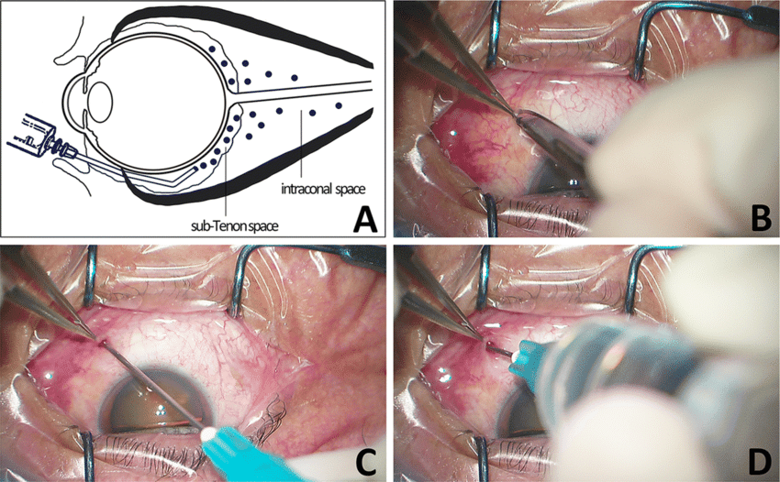

Slide 167
Sub-Tenon Anesthesia
Sub-Tenon anesthesia involves the injection of local anesthetic into the potential space between the Tenon capsule and the sclera. The inferonasal conjunctival fornix is the site most commonly utilized for injection to avoid encountering the insertion of the medial rectus or inferior oblique muscles. Anterior or posterior injection techniques may be used to accomplish sub-Tenon anesthesia. Anterior injections are performed superficially just beyond the equator using low volumes (3 to 5 ml) of anesthetic. In contrast, posterior injections provide more anesthetic into the posterior intra- and extraconal spaces; this allows for smaller volumes of anesthetic with a lower risk of chemosis

Slide 168
Complications
Failure (due to back flow of LA).
sub-conjunctival haemorrhage
raised intra-orbital pressure.
globe trauma (particularly if previous vitreo-retinal surgery,
retrobulbar haemorrhage.
Deep posterior dissection risks central spread of LA.

Slide 169
FACIAL NERVE BLOCK
A facial nerve block prevents squinting of the eyelids during surgery and allows placement of a lid speculum.
There are several techniques of facial nerve block:
van Lint, Atkinson, and O’Brien

Slide 170
Complication
subcutaneous haemorrhage.
vocal cord paralysis
laryngospasm
dysphagia
respiratory distres

Slide 171
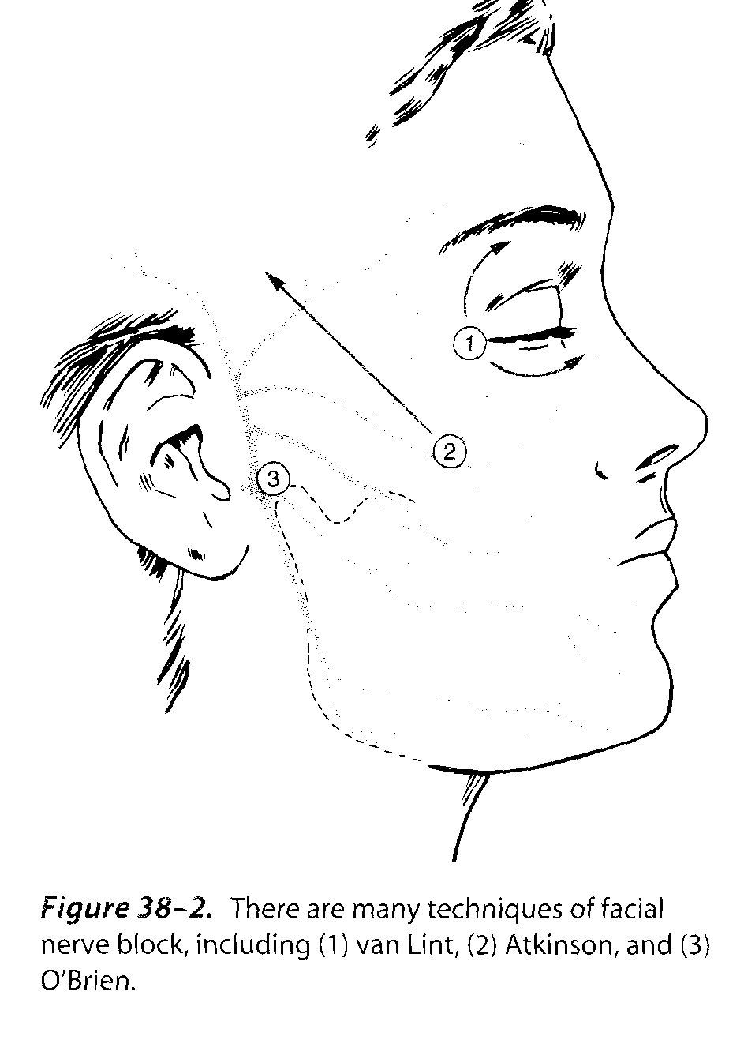
Obrien approach
Blocks branches as they pass superficial to the condyloid process of the mandible

Slide 172
Atkinson approach
Blocks branches at their intermediate position as they pass along zygoma

Slide 173
Vanlit approach
Blocks branches at their termination along the orbital margin

Slide 174
Drug dosage
For orbicularis occuli block –lidociane 2% 5-10ml
For RBB-lidocaine 2% with or with out adrenalin 4ml

Slide 175
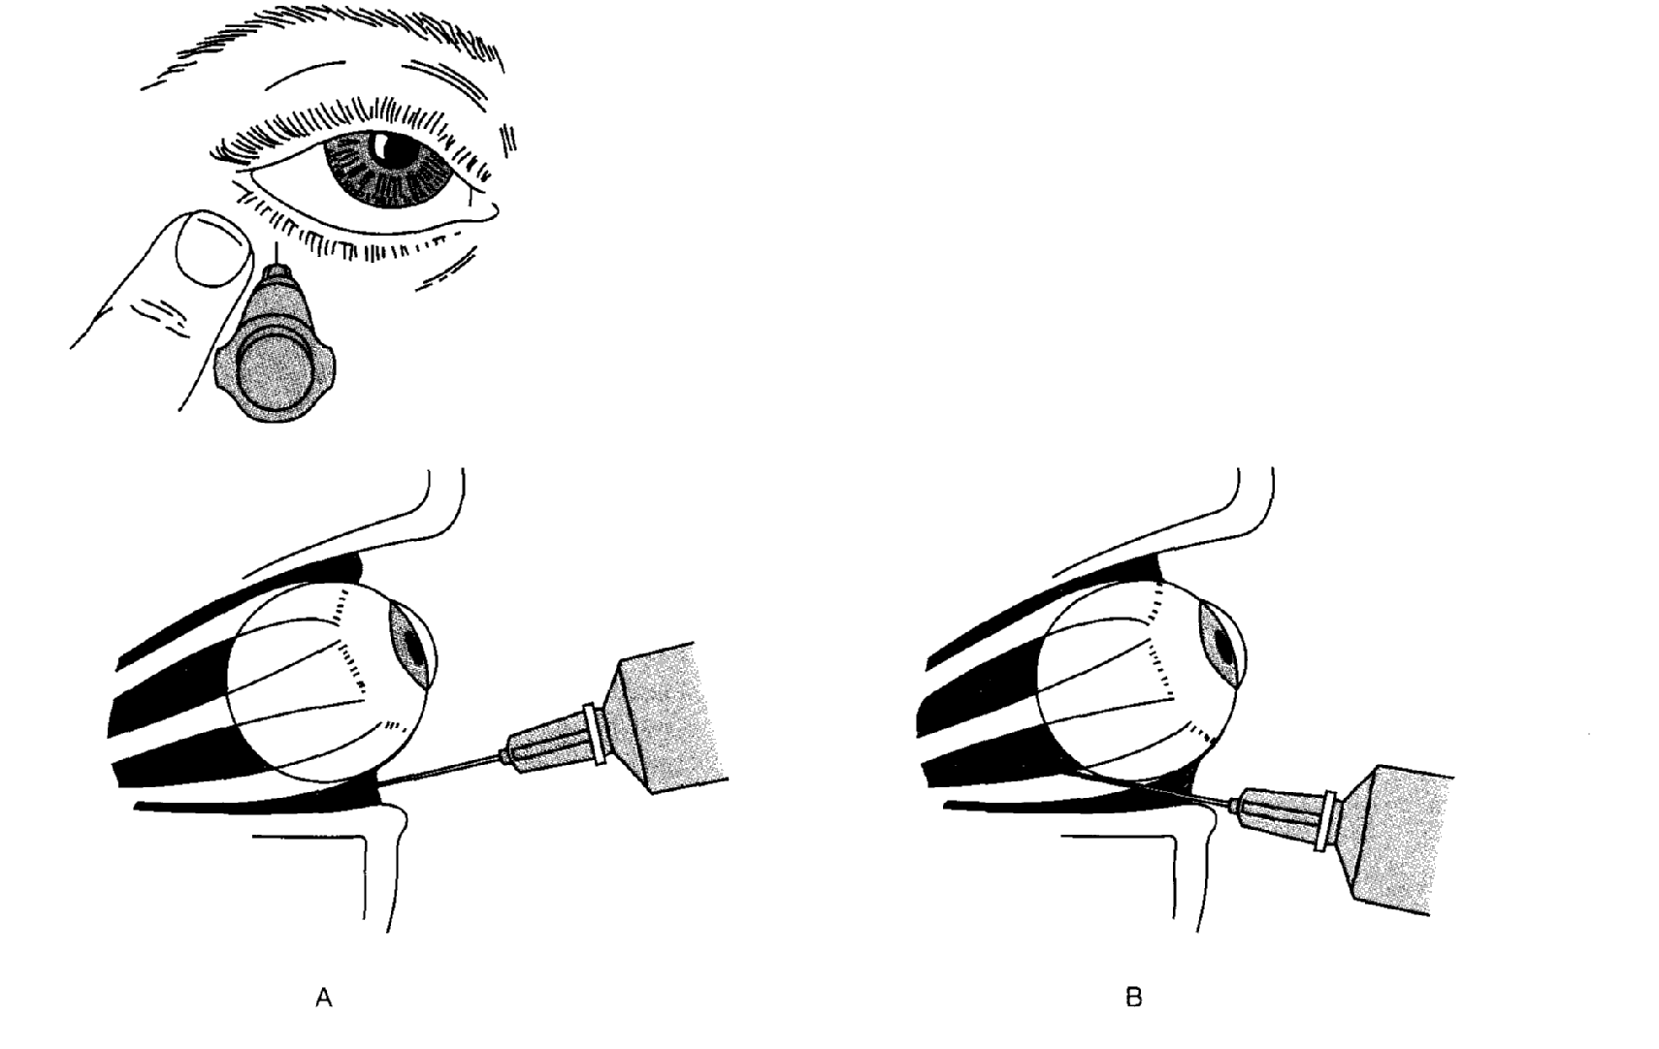
Retro bulbar block
Injecting LA solutions into extra ocular muscle cone posterior to the globe of the eye Junction of lower third with middle third

Slide 176
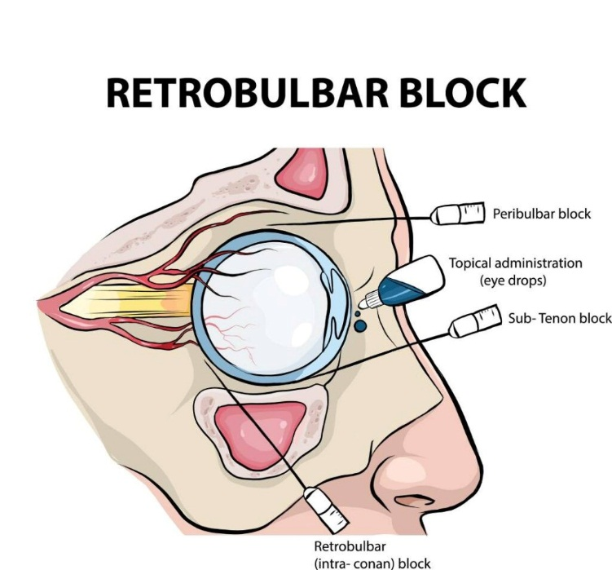

Slide 177
Preparation
1.Informed consent, including discussing risks, benefits, and alternatives, is an essential step prior to any procedure.
2.Anatomical landmarks should be evaluated before starting the procedure, with special attention to potential challenges and complications.
3.Required equipment should be collected and organized,
4. The location of the procedure should be confirmed and marked.

Slide 178
Equipment for Retrobulbar Block
Povidone-iodine 5% ophthalmic preparation
Topical anesthetic drops (e.g. proparacaine hydrochloride 0.5%, tetracaine hydrochloride 0.5%)
Anesthetic agent (generally without epinephrine in seeing eyes, as it may cause vasoconstriction with resultant central retinal artery occlusion and irreversible loss of vision)

Slide 179
Sterile gauze
Syringe: 5 to 10 mL
Needle: 23 to 25 gauge, 30 to 38 mm in length
Local anesthesthetic (lidocaine 2% with or with out adrenalin 4ml)

Slide 180
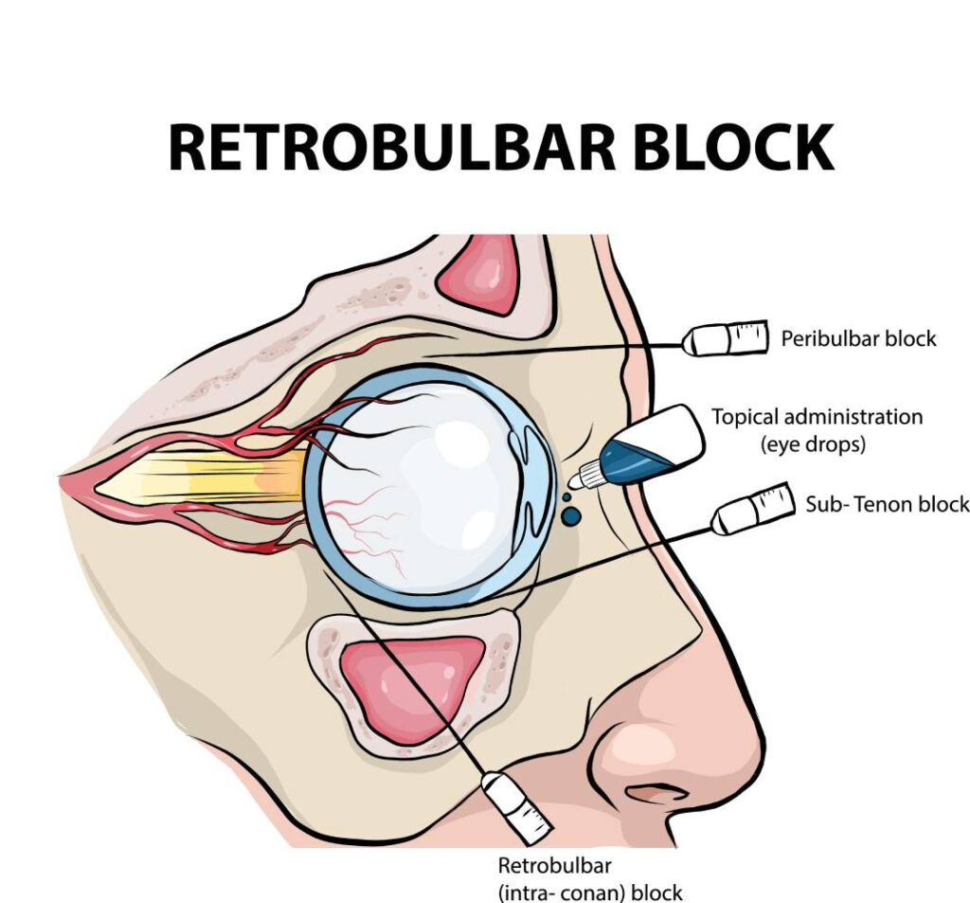

Slide 181
Complications
retrobulbar hemorrhage
globe perforation
optic nerve atrophy
frank convulsions
oculocardiac reflex
acute neurogenic pulmonary edema
trigeminal nerve block
respiratory arrest.

Slide 183

Thank you

Slide 184

Thank you

